Slide 1
Inverloch Surf Life Saving Club
Our Environmental Impact Story

Slide 2
Environmental Impact - Timeline
ISLSC club house constructed 2010/2011 – Cost $1.5M
Elevated patrol tower sited on beach and subjected to erosion from wind and king tides - 2014/2015
Sandbags placed around the base of the elevated patrol tower due to erosion issues - 2015/2016
Elevated patrol tower removed from beach by council -2016/2017. New access track created. Skid mounted tower utilised
Skid mounted patrol relocated due to severe erosion – July 2018 (See media release & photos)
Wet wall positioned in front of clubrooms 2018/2019
Trailer mounted patrol tower utilised. 2019/2020
Row of geo-sandbags positioned between wet wall and clubrooms 2020/2021
Minor works to augment sand stockpile either side of geo-sandbags and access track repairs 2021 to 2024
This week - Carnage.
We are now at the 2040 trigger point mooted in the Cape2Cape Report

Slide 3
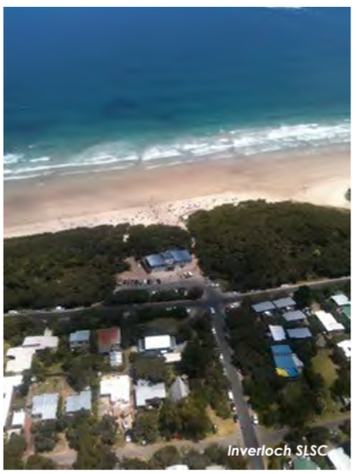
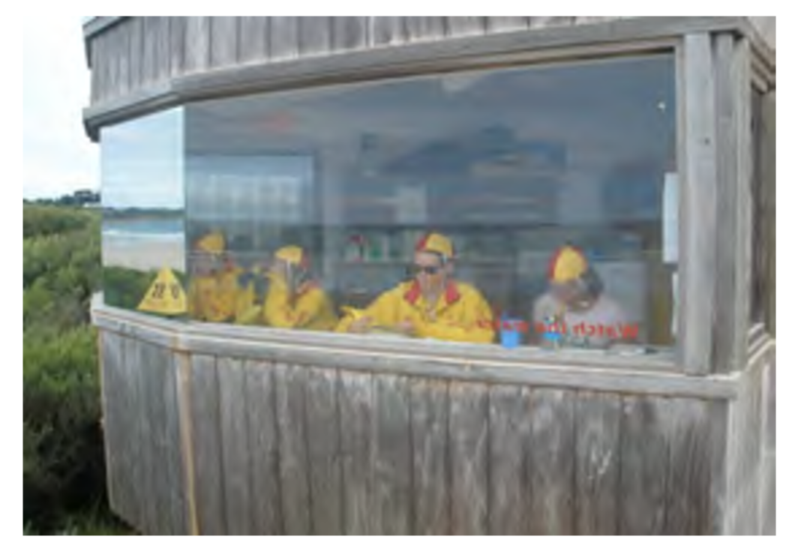
ISLSC Clubhouse & Patrol Tower 2010
Tower Located just to the right of the access Track

Slide 4
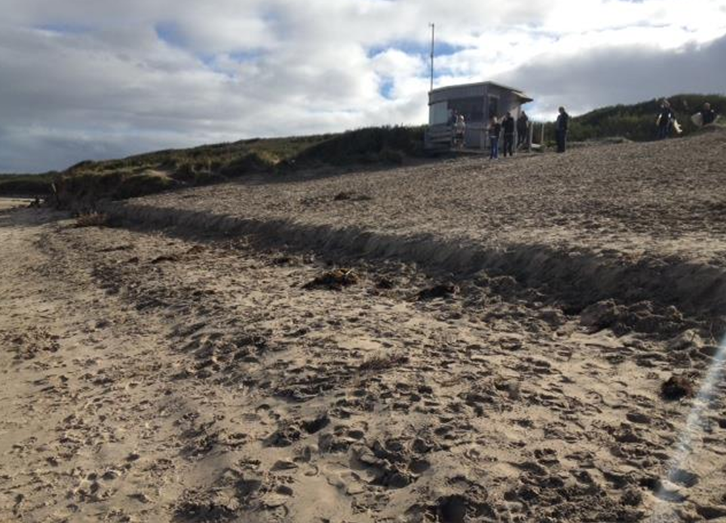
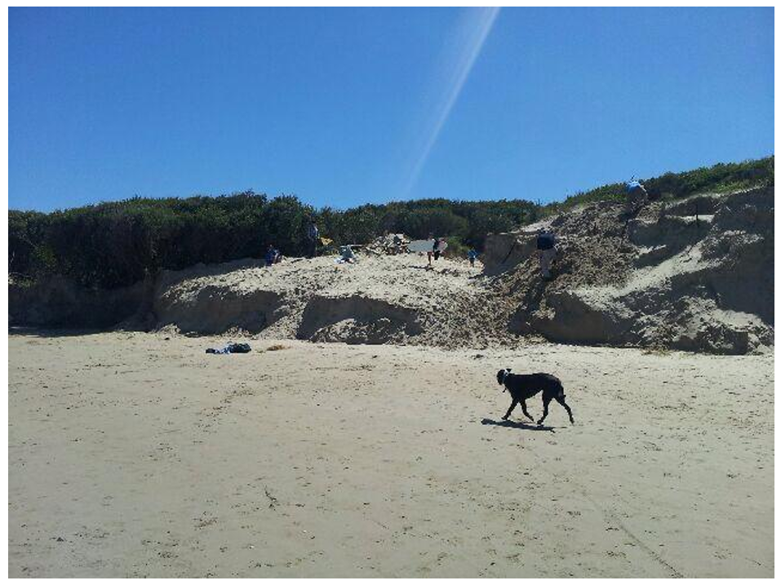
Patrol Tower then No Patrol Tower Due to Erosion 2013/14

Slide 5
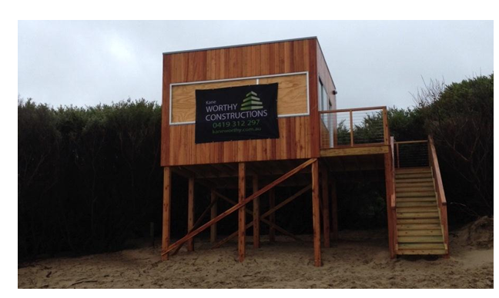
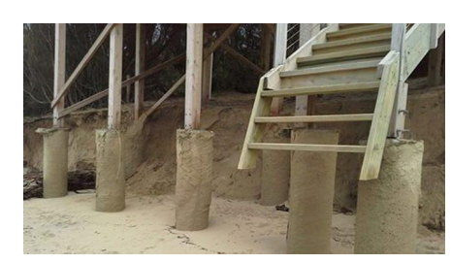
The supporting structure for the new patrol tower
not long after it was constructed
New Elevated Patrol Tower 2014/15

Slide 6
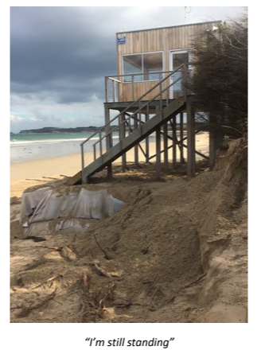
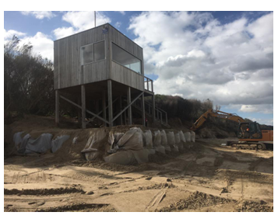
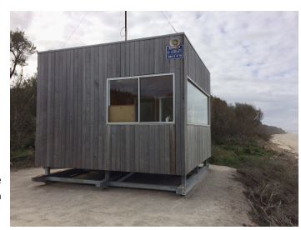
2016/17 Season
Transition from Elevated tower to
Skid base tower at a new location
2015/16 Season

Slide 7
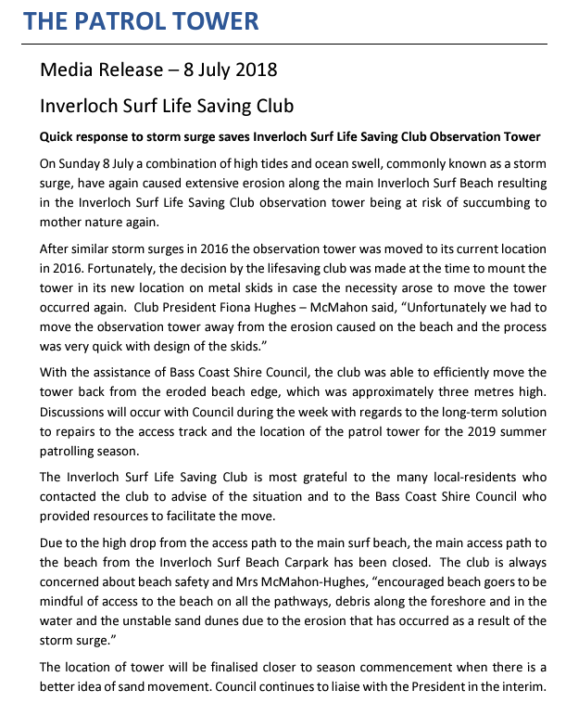
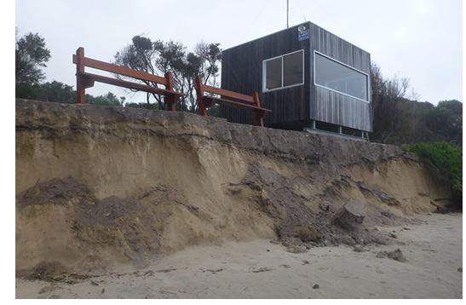
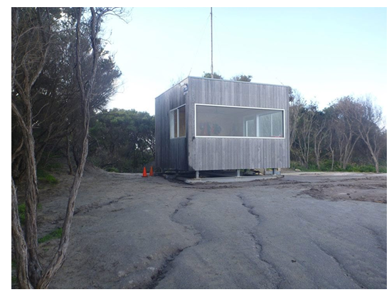

Slide 8
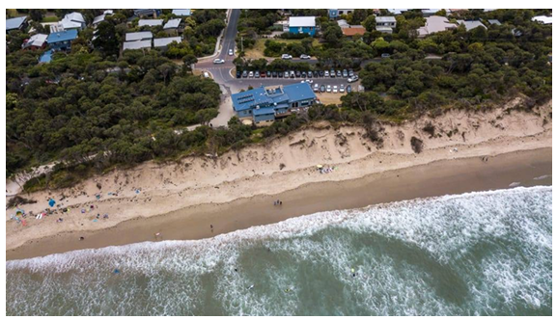
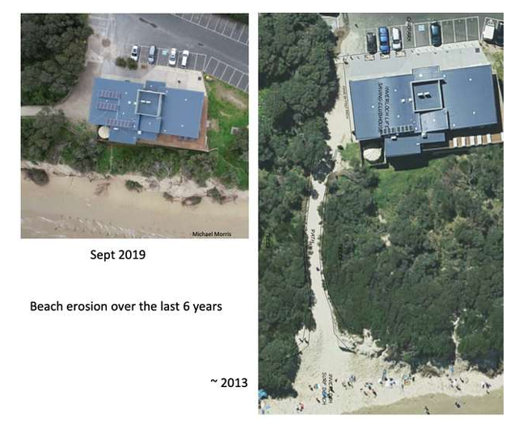
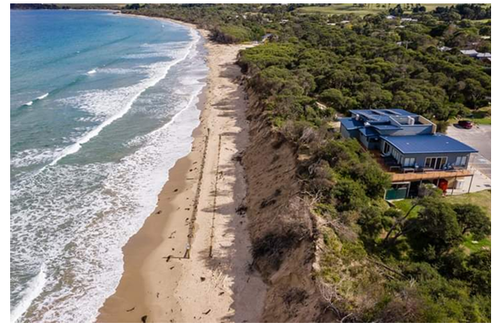
Clubhouse & Beach 2018/19
Note Wet Wall
Erosion comparison 2013 to 2019
Over 60m of beach & dune lost

Slide 9
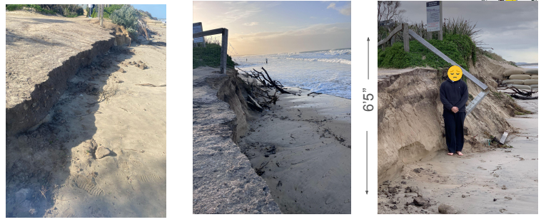
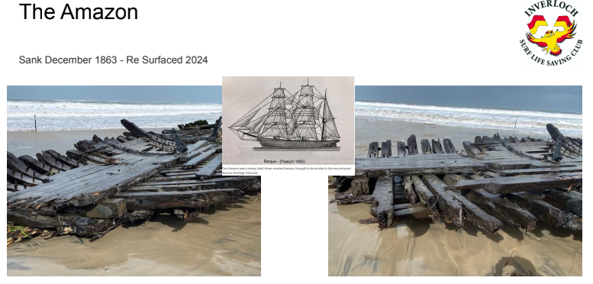
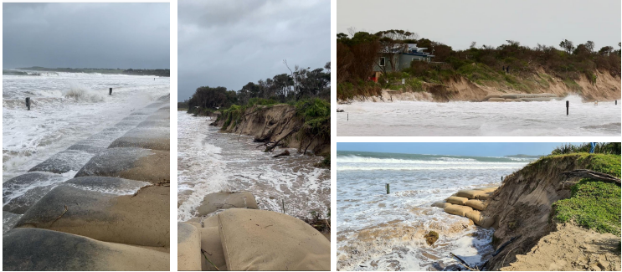
This Week

Slide 10
Who is responsible for making things happen?

Slide 11
As a key community stakeholder in the direct line of fire
We Don’t Know
as our representative withdrew due to extreme frustration and the total lack of urgency in the current process

Slide 12
Environmental Response - Timeline
Cape to Cape Resilience Project Commenced – 2020
Survey #1 Coastal values & experiences – 2021
Survey #2 Coastal Hazards and adaptation actions – 2022
Survey #3 Adaptation actions for different Cape to Cape locations – 2023
Community pop-ups - ?
Online community workshop - ?
Draft Report – 2024
Report Adequacy – Completely useless and out of date

Slide 13
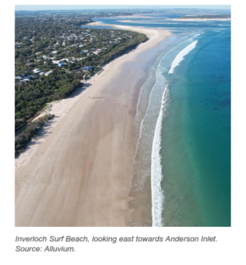
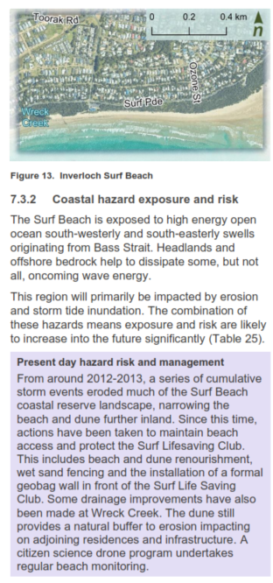
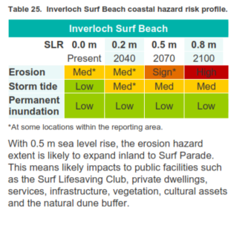
Resilience Plan - Inverloch Surf Beach

Slide 14
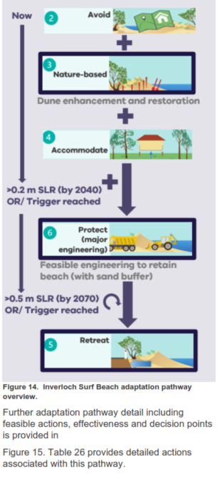
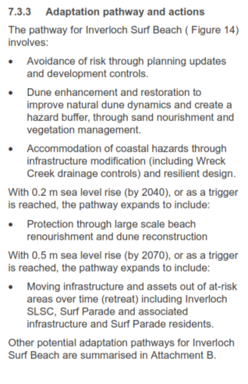
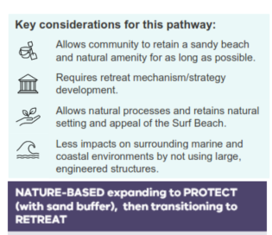
Resilience Plan - Continued

Slide 16
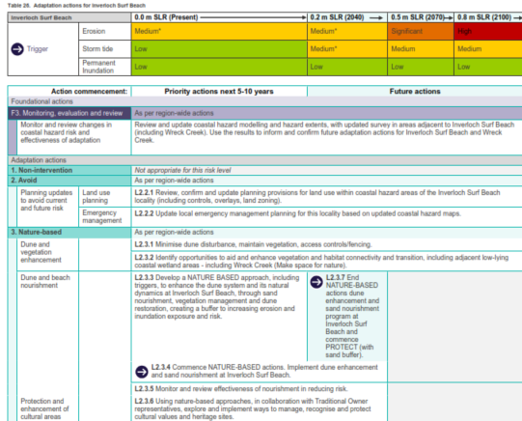

Slide 17
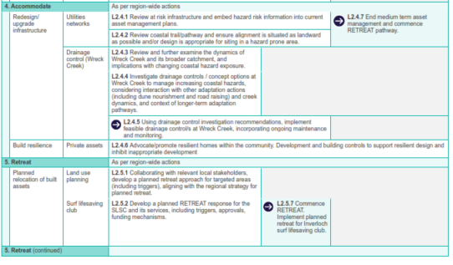

Slide 18
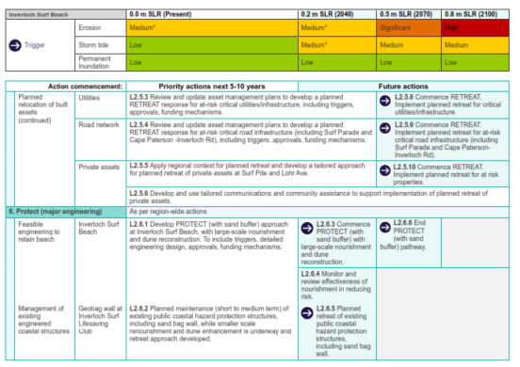

Slide 19
In the meantime
Dune erosion surfside has continued unabated
Dune creep is taking place along surf parade where path and remedial works have not been carried out
Anderson Inlet entrance has become more hazardous due to the changing chanel conditions primarily due to sand and debris build up
Sand draw for selective remedial works has potentially exacerbated the erosion issue
No tangible solutions to the erosion problem have been put forward or trialled

Slide 20
The council has reneged on extending the footpath from Ozone Street to the Surf Club rooms (The endorsed community format) citing the primary reason as DEECA won’t allow it to happen due to erosion of the dunes. When in reality a well designed pathway could underpin the long-term solutions for dune erosion and encroachment onto community infrastructure and the residential areas along surf parade.
Consequential results for the club are
Significantly greater numbers of beachgoers and swimmers opting to swim in an uncontrolled area which due to its location has higher degrees of water safety risks
Having to perform more rescues in the inlet chanel
More congestion in and around the clubroom parking area due to impediment of traffic
Increased difficulty in responding to rescue operations away from the surf beach area

Slide 21
Inverloch Surf Life Saving Club
Overview of our club
September 24

Slide 22
General Statistics
Membership
Source: Life Saving Victoria July 2024

Slide 23
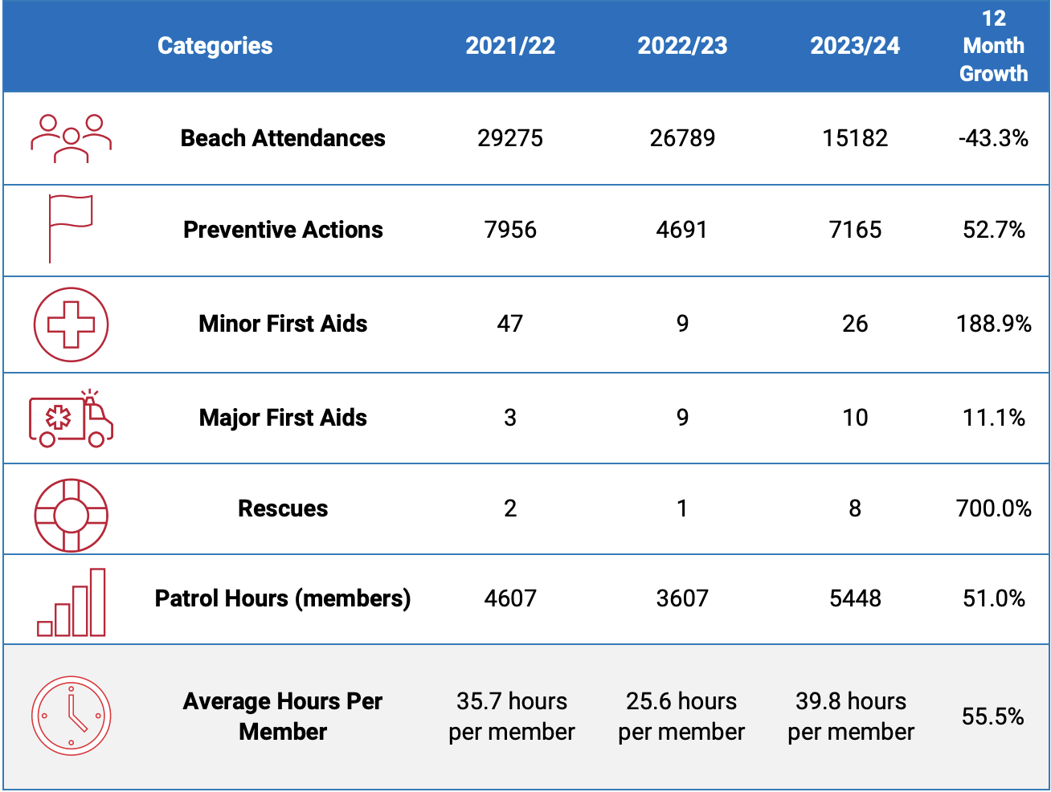
General Statistics
Operational

Slide 24
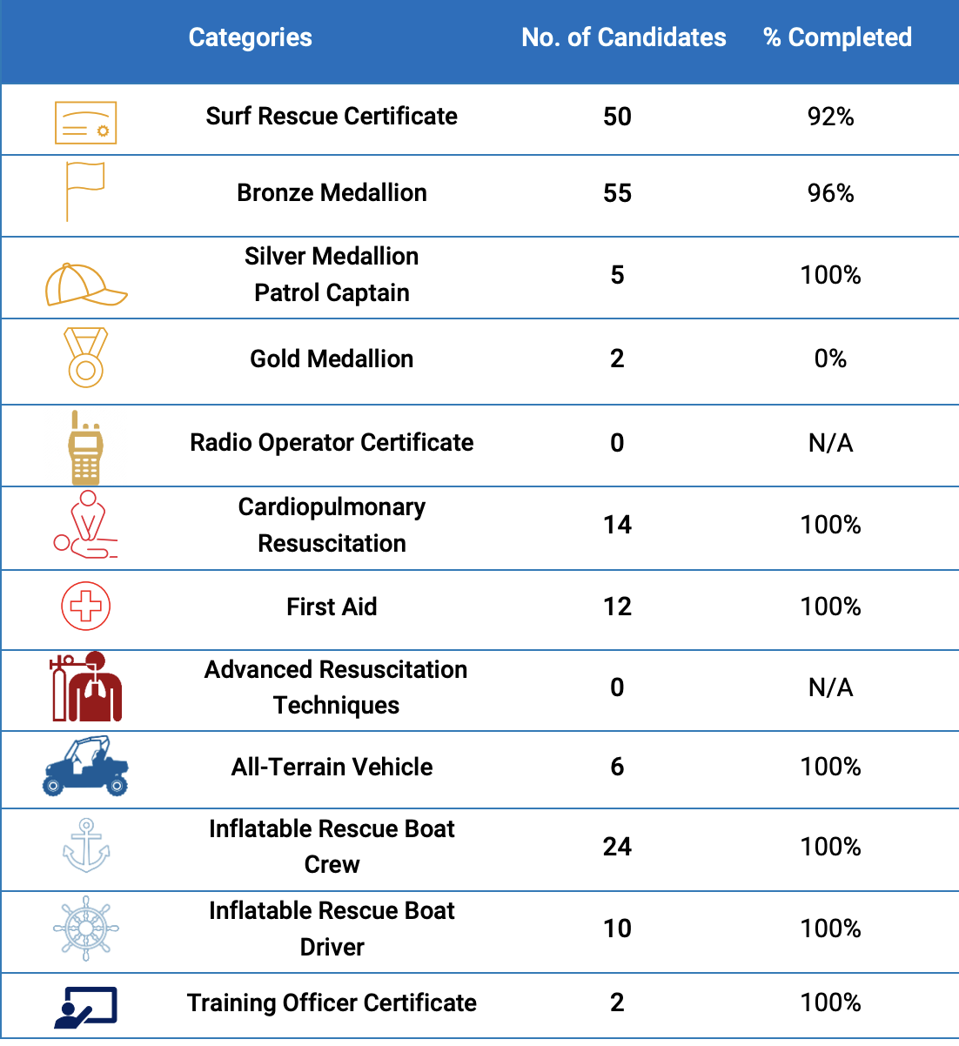
General Statistics
Training

Slide 25
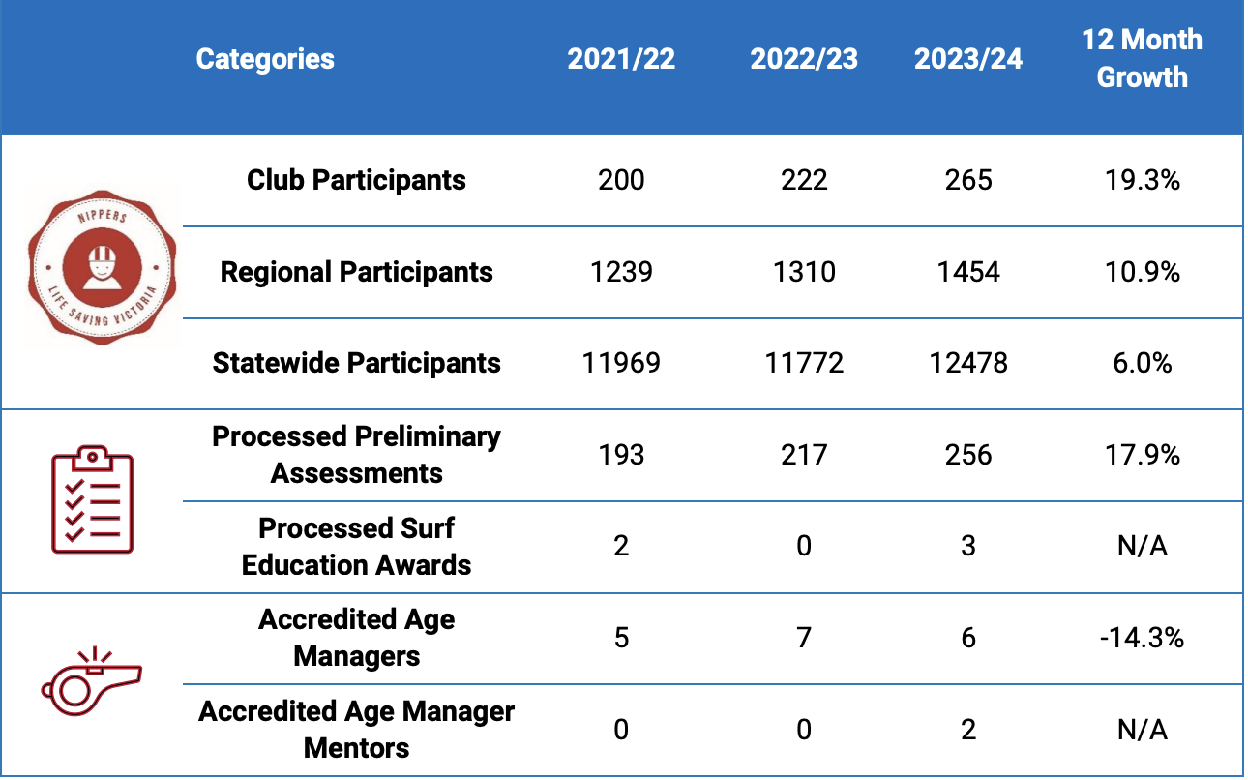
General Statistics
Training

